Slide 1

Welcome to the crypto casino!
By Kelly Reynolds, Peter Pressley, Ryan Gehan and Juliana Merlino

Slide 2

Overview
Meet the Team
Overall Idea
Our Motivation
System Overview and Software Process
Demo
Lessons Learned

Slide 3
Team
Frontend
Peter Pressley - App Creation
Kelly Reynolds - Game Visuals
Backend
Ryan Gehan - Smart Contract
Peter Pressley - Game Creation
Kelly Reynolds - Game Creation
Juliana Merlino - Game Creation

Slide 4

Overall Idea
Create a Crypto Casino environment where users can bet their crypto for the chance to win more crypto in the process
Allow users a fun way to get into cryptocurrency and create more interest to a wider group

Slide 5
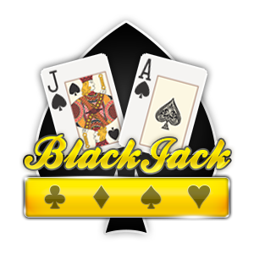
motivation
Allow user to enjoy Casino games while betting cryptocurrency
If the user wins, they will be able to win crypto in return
If the user loses, the Crypto Casino (us) will be able to profit off of this loss
To allow those who may be new to crypto begin to get into it without being in over their heads

Slide 6
OUTCOME Functionality
Ask user to enter age to ensure they are over 21
Connect Metamask wallet to the page
User can choose between Blackjack, Random Number Guesser, Spin a Wheel
Enter amount of ETH the user would like to bet
A transaction will take place between the user’s wallet and the contract
Depending on results, the player loses their crypto or receives a transaction of ETH (Goerli) to their wallet containing their earnings

Slide 7
How does it work
Game Functionality
Front End
Backend
Blockchain
Display game
withdraw() deposit()
Connects to
User
(picks a game and plays it)
Send ETH
Users Wallet
Smart Contract

Slide 8
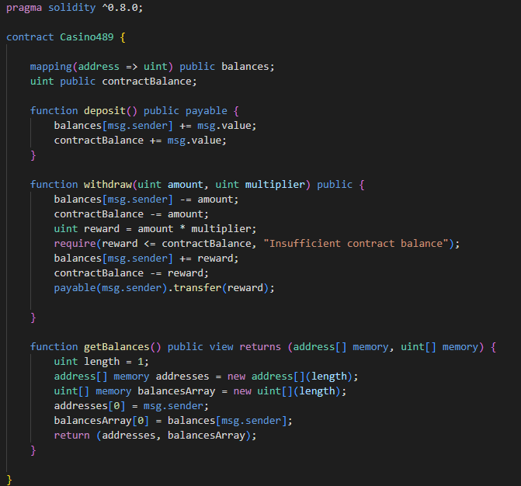
CONTRACT
deposit() - accepts ETH from the user and stores the new user and contract balances
withdraw() - sends a certain amount of ETH back to the user
reward = amount * multiplier
getBalances() - returns the balances of all of the users that have deposited more than 0 ETH
balances - mapping that stores the total ETH available to use for each user (connected to their address)
contractBalance - stores the total balance for the contract

Slide 9
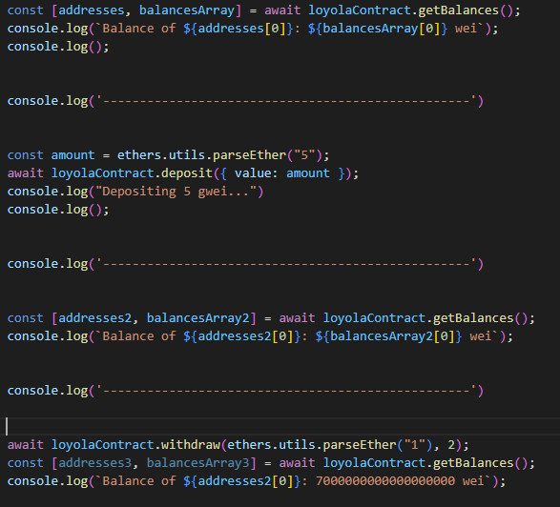
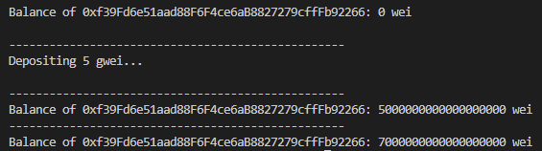
CONTRACT Example
*Disclaimer* due to the way that the faucets work, the contract can not actually afford to pay out ETH to the user if they win

Slide 10
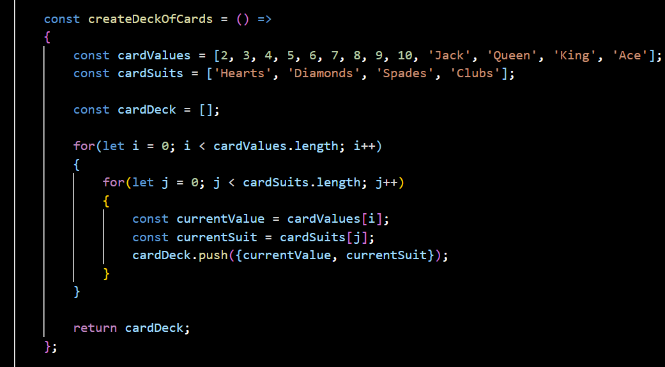
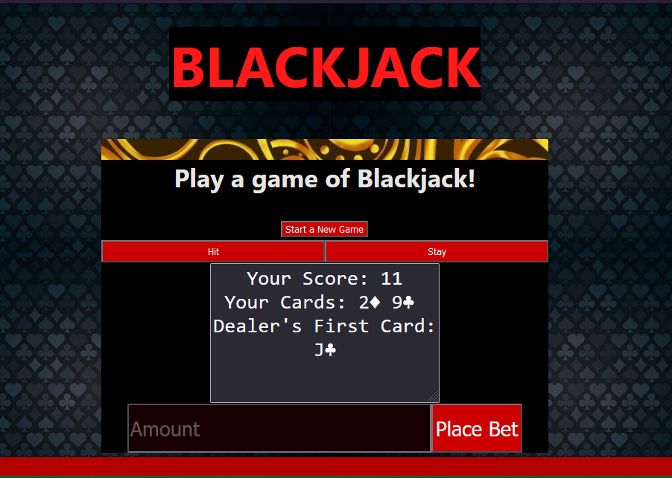
Blackjack
Deals two cards to player and two cards to dealer Player chooses to hit or stay - dealer draws until 17
Display player’s hand and first card of dealer’s hand Displays winner and both decks

Slide 11
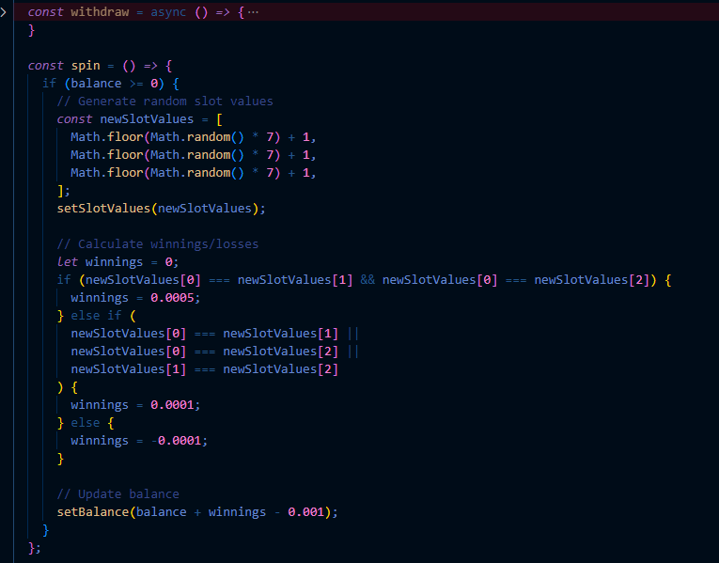
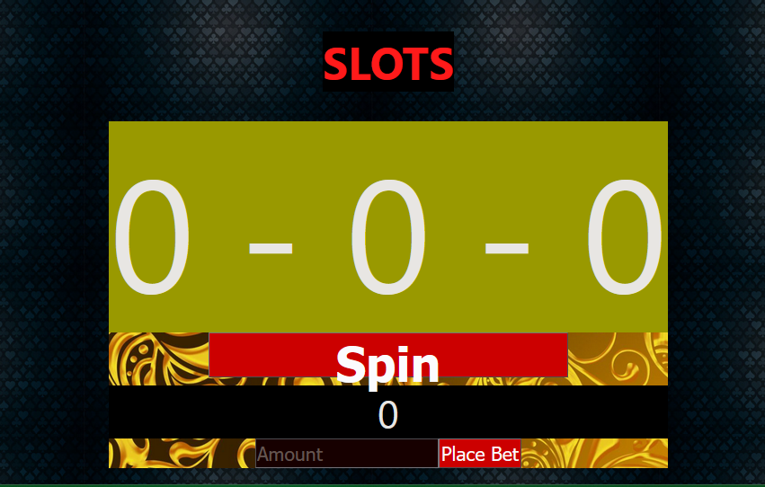
slots
Three number options, if all equal win big prize, if two equal, win smaller prize, if none equal, lose crypto

Slide 12
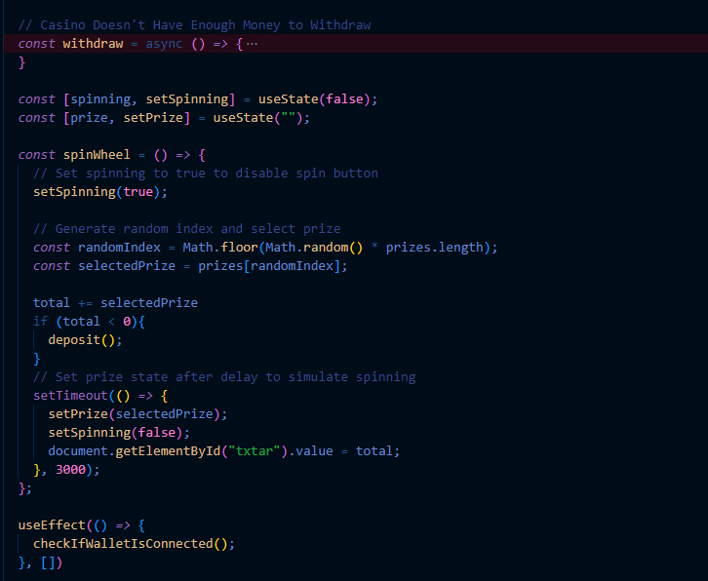
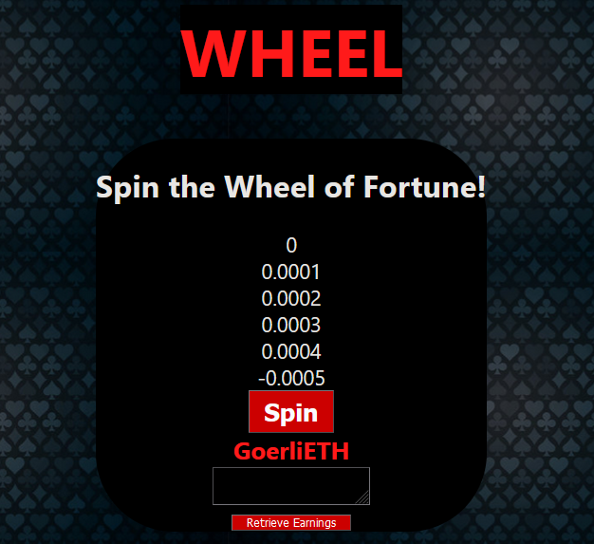
Wheel
User can click to generate a value from a wheel - user is then awarded or penalized given value

Slide 13
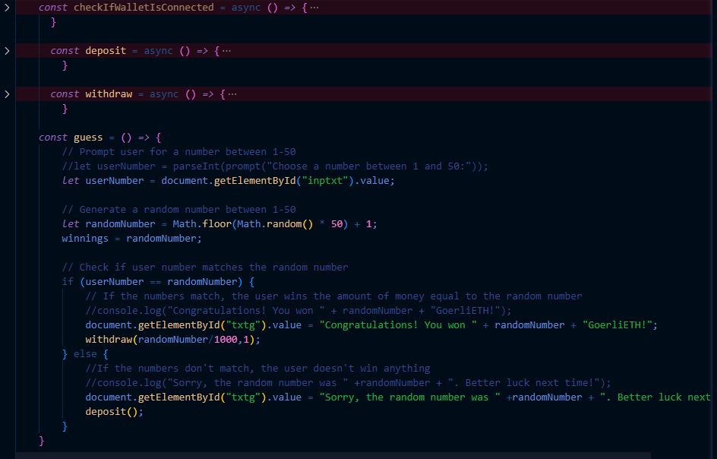
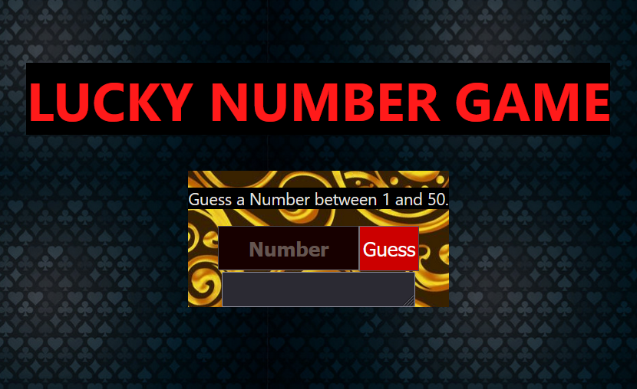
Lucky Number
User enters a number between 1-50, if right wins reward, if not, penalized

Slide 14
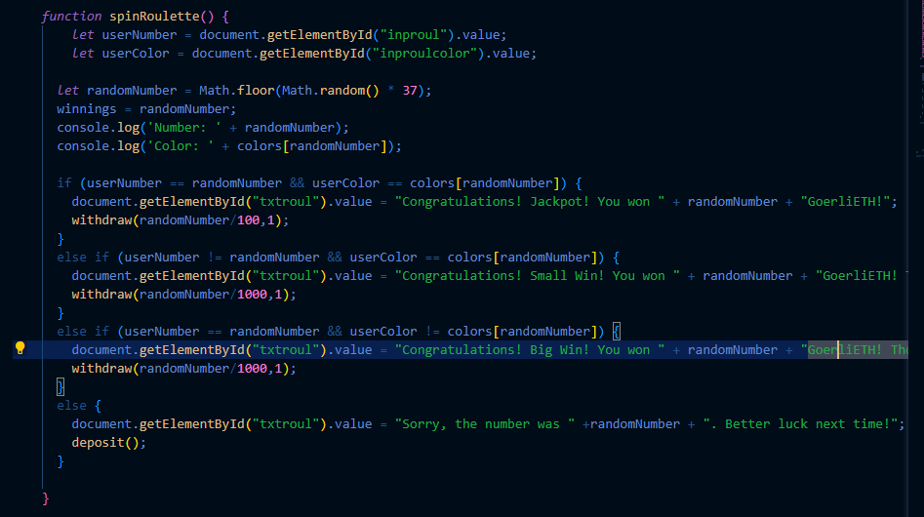
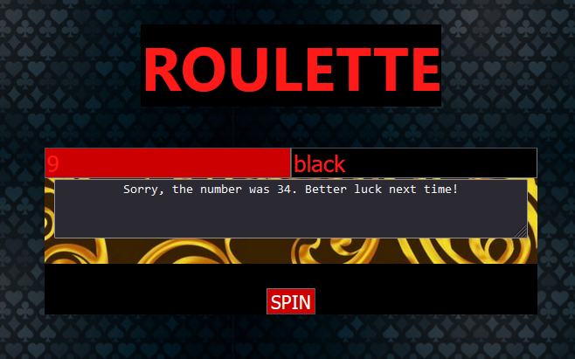
Roulette
Plays a simple game of roulette - user guesses number and color and is rewarded or penalized accordingly (more reward for guessing correct number / correct number and color)

Slide 15
Demo

Slide 16
Lessons learned
Be realistic in time and abilities - we created multiple games, but each one had its own bugs and difficulties
Pick a different test cryptocurrency - did not have as much access to Goerli as desired
Learned more about React and frontend side of things
Communication is key
Everyone brings different strengths to the group

